Slide 1


Apps, Arts and Issues:
APP-lying the Arts to Digital Communication
Team Members: Jose Ayala, Claudia Gourdet, Derek Hernandez,
Enrique Hidalgo, Mariel Juarez, Nathalie Llaneza, Ranses Melo
Product Owner: Dr. Steve Rios
Instructor: Margo Berman, Francisco Ortega
School of Computing and Information Sciences,
Communication, Architecture + The Arts
SUMMER 2017

Slide 2
PROJECT DEFINITION
Students from IT, Computer Science and Communication worked together to develop a digital campaign for Florida Reach. Florida Reach is a network of professionals who support foster youth attain a higher education. The students collaborated to solve client’s problems but at the same time built portfolio pieces that are marketable. To better guide former-foster-care students, material was created from website to app and social media communication.

Slide 3
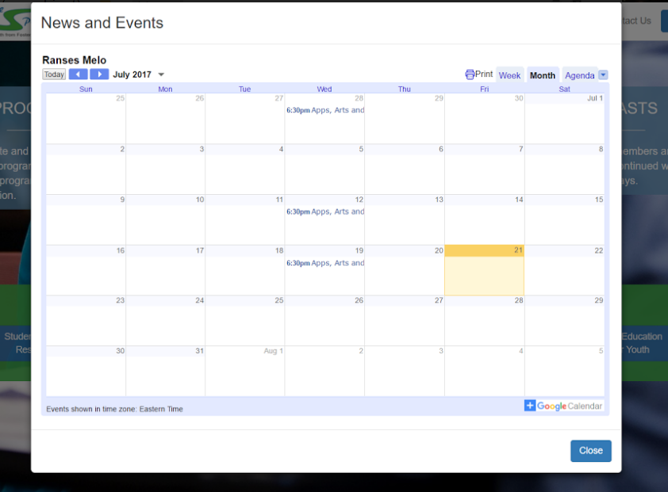
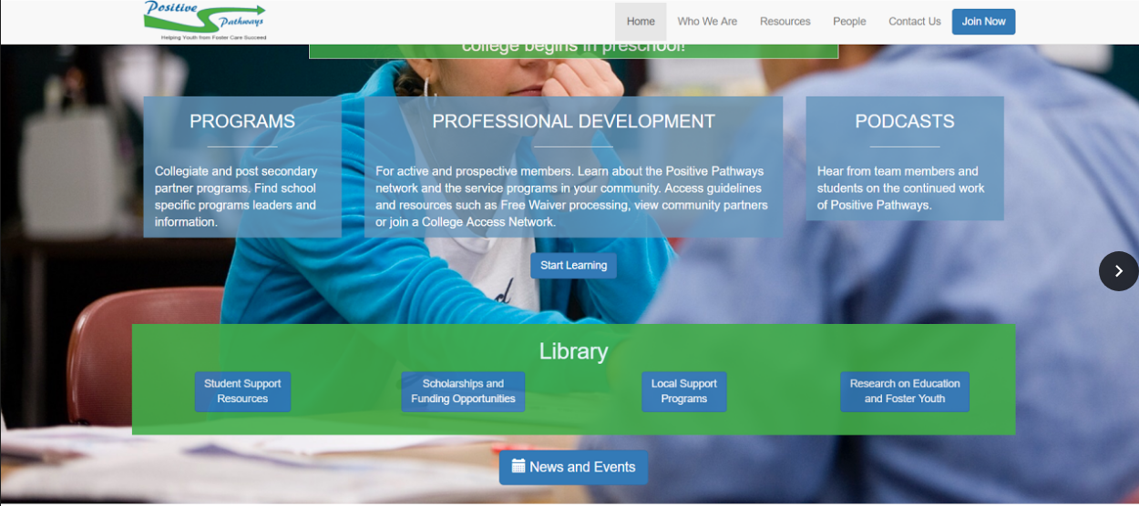
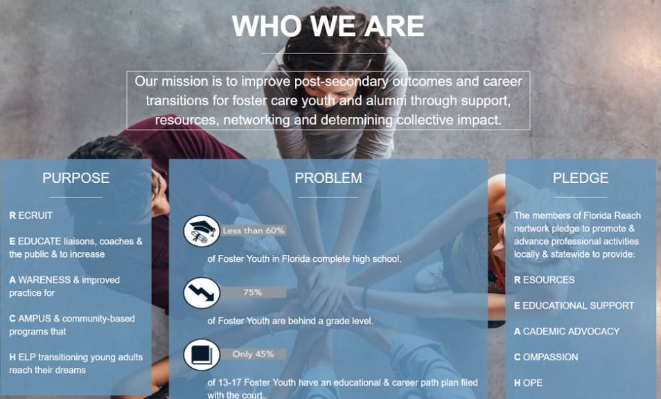
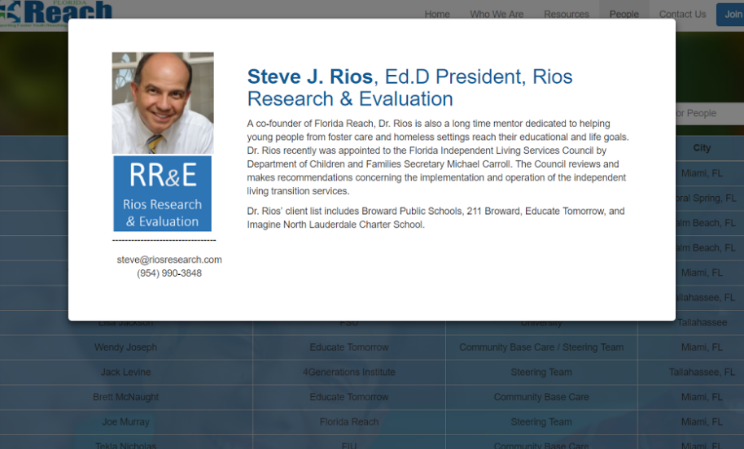
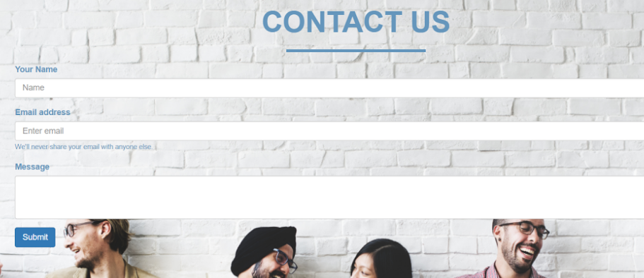
PROJECT IMAGES

Slide 4

Student Work

Slide 5
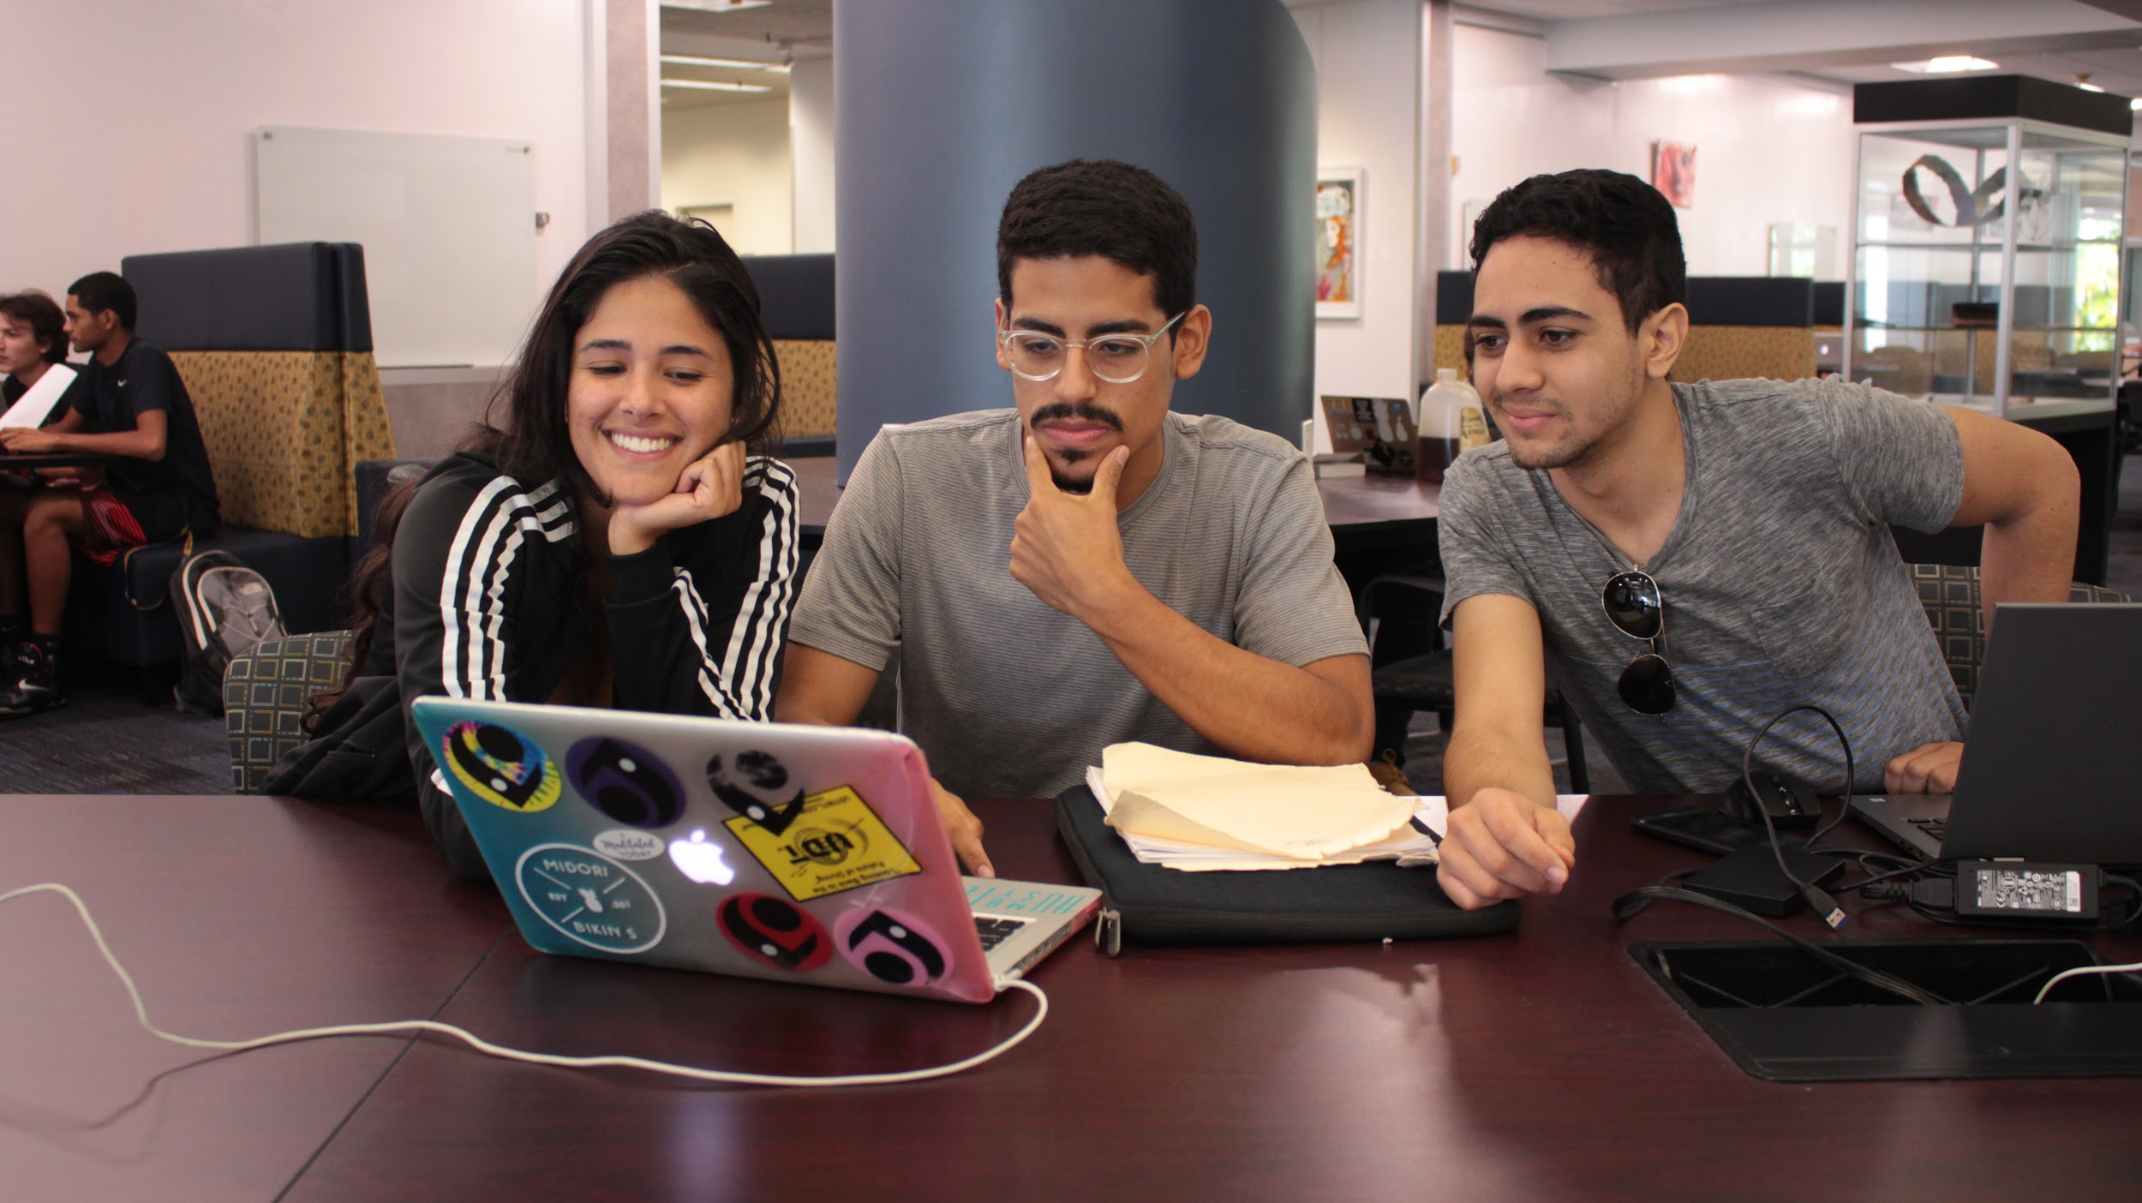
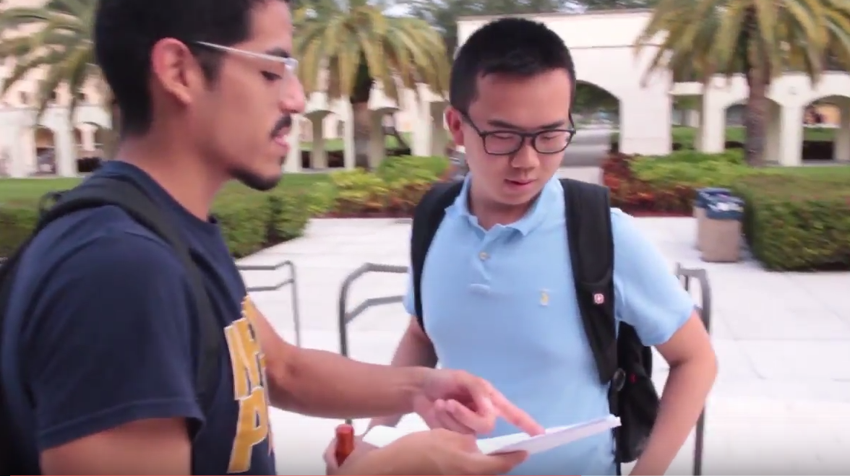
COMMUNICATIONS
Finding ways to engage the audience
Creating an image for Florida Reach
Balancing creativity and Florida Reach’s message

Slide 6
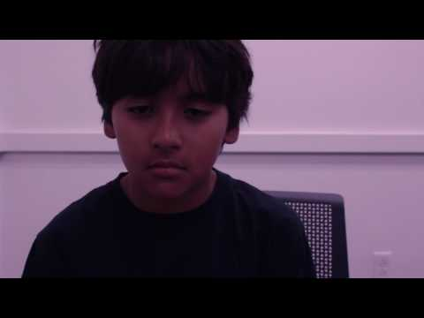
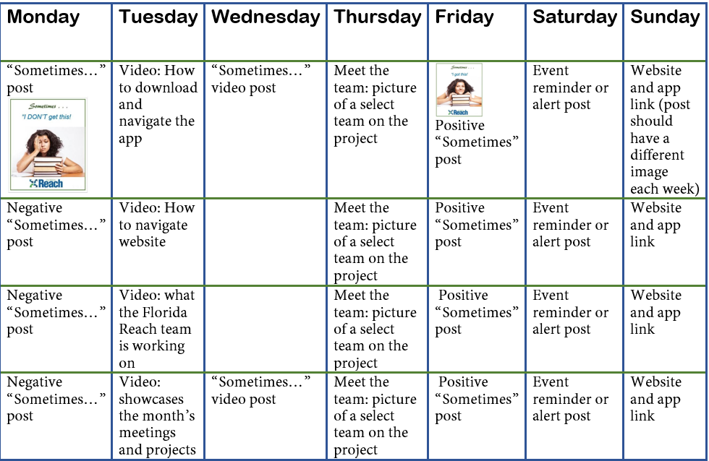
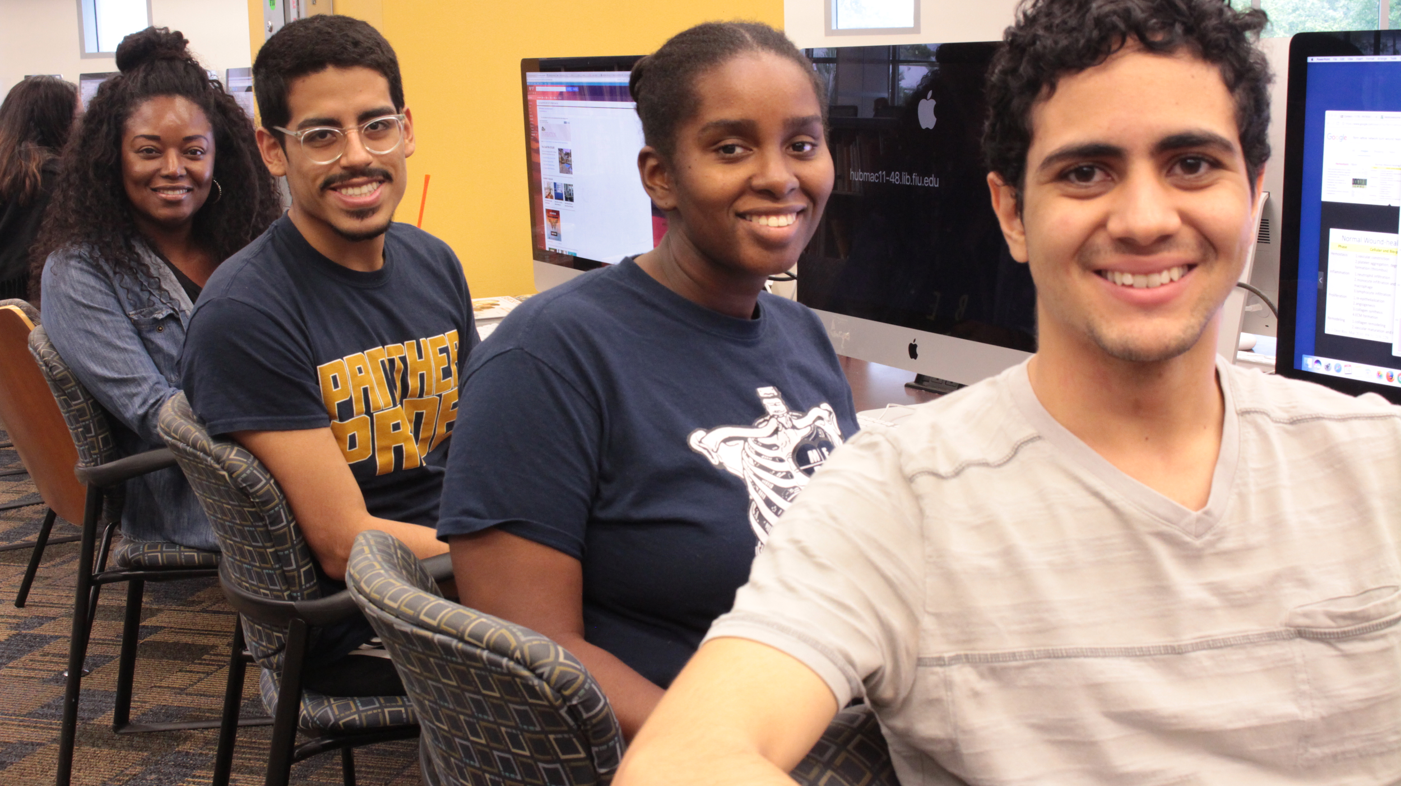
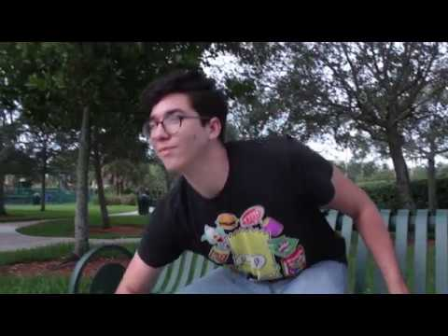
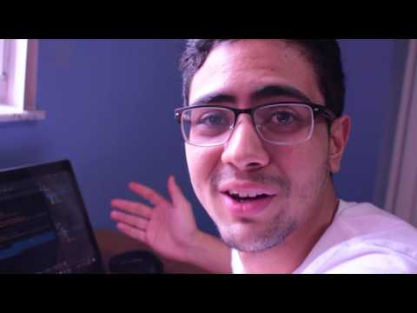

Derek Hernandez
Filmed, directed and edited “Reach” videos
Photographed models
Developed social media calendar for future Instagram account
Edited and filmed for the final team video
Equipment: Canon Rebel T5i

Slide 7



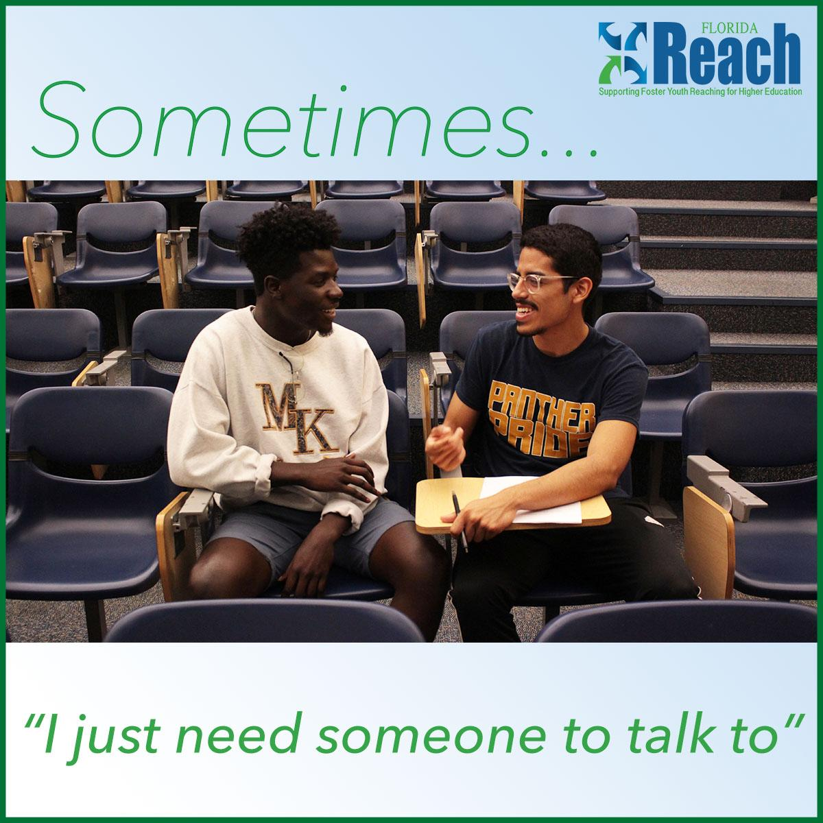

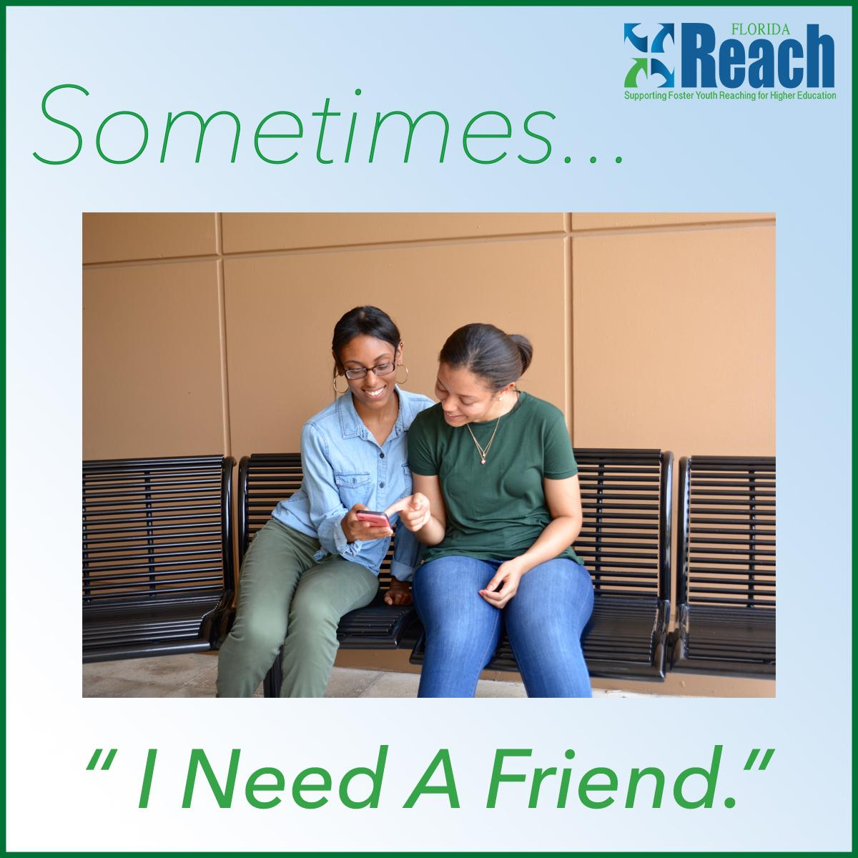

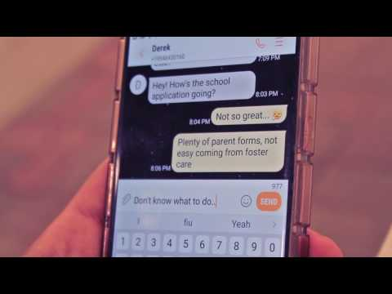
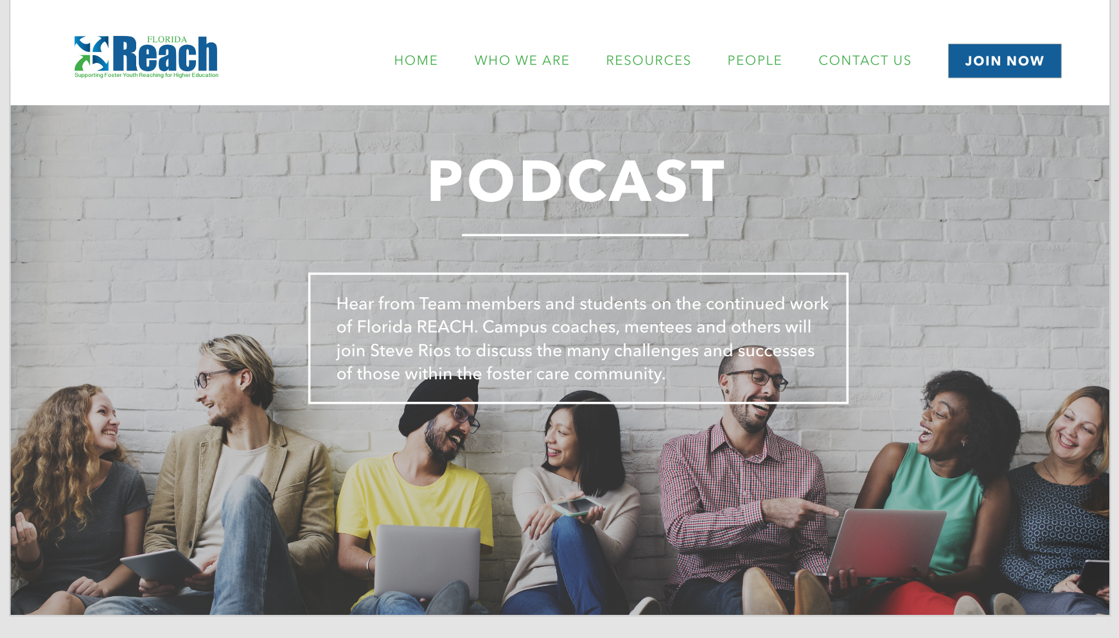

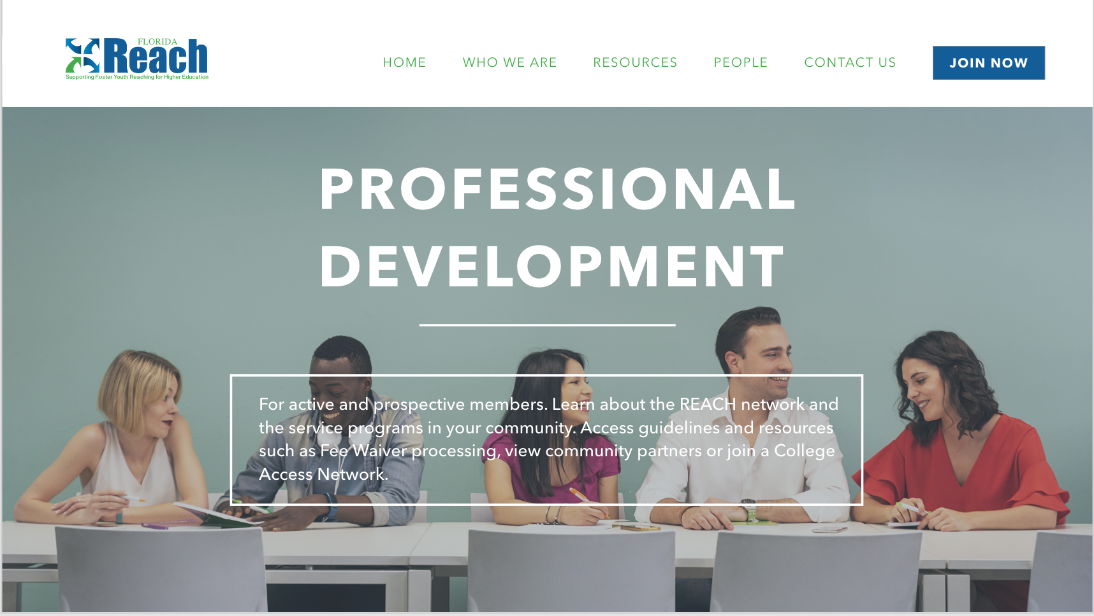

Enrique Hidalgo
Tasks
Created media to augment client’s online presence.
Developed template for “Sometimes” graphics.
Filming and post-production of “Reach” commercials.
Photographed models.
Involved in “Thinkivators” logo conceptualization.
Grammar and spell check for Website copy. Mitigated navigation solutions.

Slide 8
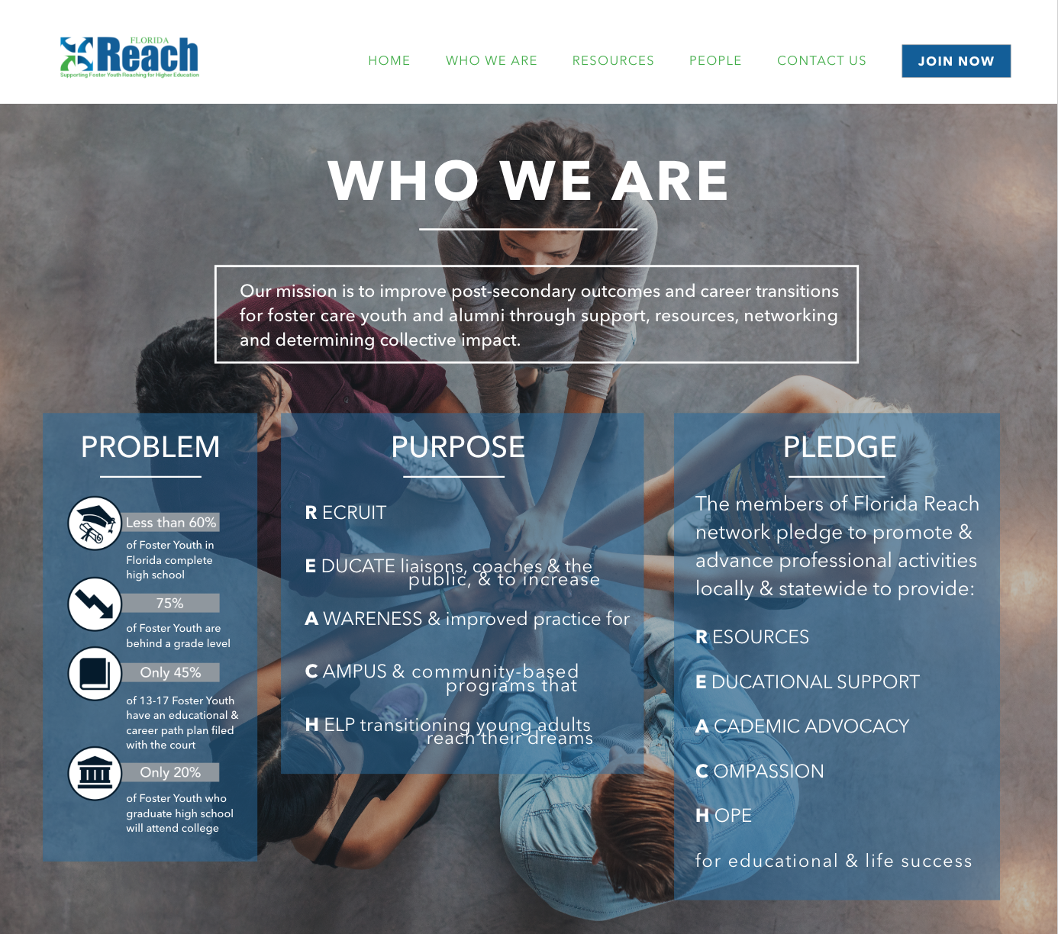
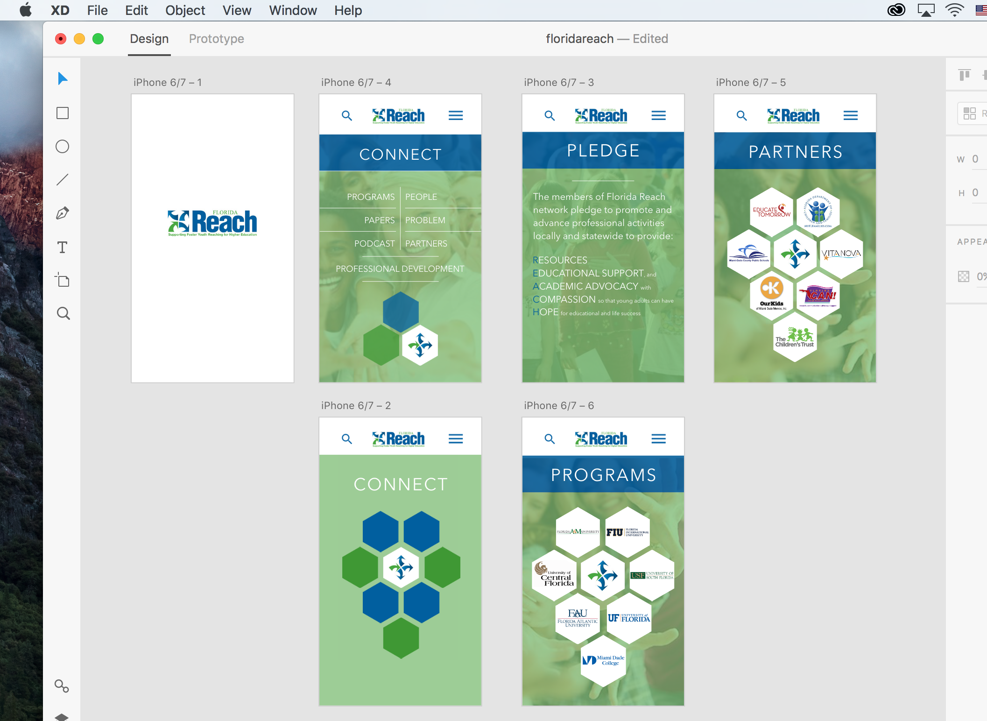
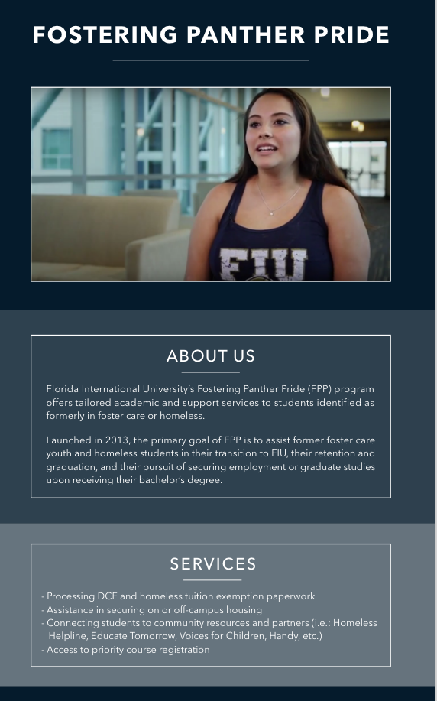

JOSE AYALA
Developed mock up of the Florida Reach App
Developed website design template for Florida Reach
Assisted in designing a logo for our team “The THINKivators”
Programs utilized: Adobe Experience Design & Photoshop

Slide 9


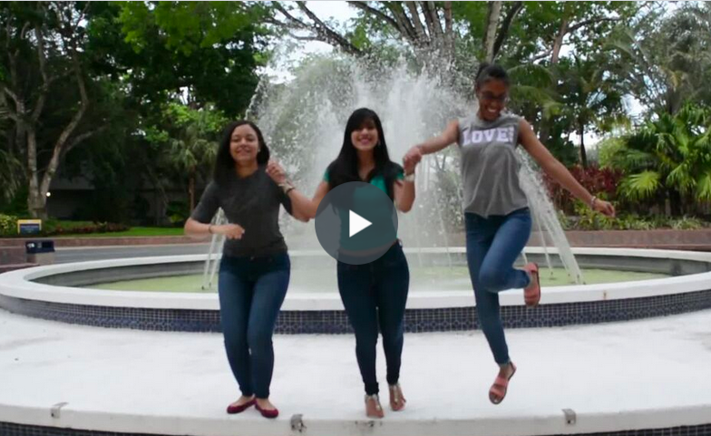
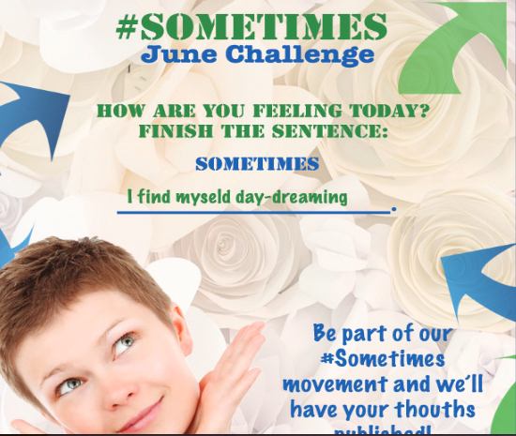

Mariel Juarez

Slide 10
USER STORIES
ENRIQUE HIDALGO #671 Sometimes Campaign -Images/Graphic
RANSES MELO #687 Calendar/Upcoming event
CLAUDIA GOURDET #683 Programs List for School and Universities
DEREK HERNANDEZ #694 Florida Reach Commercial
MARIEL JUAREZ #698 Worked on the THINKivators Logo
JOSE AYALA #663 Florida Reach STAT- Graphic

Slide 11
User Story #1
#671 Sometimes Campaign -Images/Graphic
Description:
As a graphic designer I brought the client’s ideas to fruition. Preparing various media that reflected foster youth attitudes and experiences with higher education.
Acceptance Criteria:
Visually appealing
Clear message
Campaign captures experience of foster youth
Picture must match feeling presented – words must matched
Diversity of Subject ( African American , Hispanics, White.. etc)
Notes:
60 seconds
The tile of user story
The most important user story you worked on it. You have to describe this one very well and be proud of that.
Please present and show the complexity of your work, code, algorithms, and technical challenges and technologies you have used. (you could use screenshot if you want. Visual presentations are better than text presentation)
Go into the details of the most important/significant tasks using bullet lists or visual graphs or state chart diagram
Sequence Diagram for this user story is mandatory (in another separate page if required)
Demo using screenshots or GIF (in another separate page if required)

Slide 12
User Story #2
#687 Calendar/Upcoming event
Description:
As a Positive Pathway member /interested party I want to view upcoming events so that I can stay inform and engage with positive Pathway
Acceptance Criteria:
Calendar Must Display Month, day , Year
Acceptable in list for With title “ Upcoming Event”
Calendar must mark particular dates Positive Pathway events/ meeting occurring
Calendar Must display all major holidays: Christmas, Easter, President’s Day, Mother’s Day, Father’s Day, Labor Day, New Year’s Day.
Notes:
20 seconds
The tile of user story
Please present and show the complexity of your work, code, algorithms, and technical challenges and technologies you have used. (you could use screenshot if you want. Visual presentations are better than text presentation) - Go into the details of the most important/significant tasks using bullet lists or visual graphs or state chart diagram - Demo using screenshots or GIF (in another separate page if required)
Sequence Diagram for this user story is optional

Slide 13
User Story #3
#683 Programs List for School and Universities
Description:
As a network member/interested party I want to view different programs Positive pathway is connected with so that I can understand the Strong programs they have and the services they have to offer for at-risk and foster care youth
Acceptance Criteria:
Programs must be the School with College coaches /Strong support program for Foster care youth
Programs description and services must be available on page
School logo is absolutely neccessary
Notes:
20 seconds
The tile of user story
Please present and show the complexity of your work, code, algorithms, and technical challenges and technologies you have used. (you could use screenshot if you want. Visual presentations are better than text presentation) - Go into the details of the most important/significant tasks using bullet lists or visual graphs or state chart diagram - Demo using screenshots or GIF (in another separate page if required)
Sequence Diagram for this user story is optional

Slide 14
User Story #4
#694 Florida Reach Commercial
Description:
As a communication student, I created high-quality videos for Florida Reach “Sometimes” campaign. This videos showcase why college liaisons should become part of Florida Reach, as well as target young adults in foster care.
Acceptance Criteria:
High-quality video
Message is clear
Florida Reach colors are visible in video
Approve by client, Steve Rios
Notes:
20 seconds
The tile of user story
Please present and show the complexity of your work, code, algorithms, and technical challenges and technologies you have used. (you could use screenshot if you want. Visual presentations are better than text presentation) - Go into the details of the most important/significant tasks using bullet lists or visual graphs or state chart diagram - Demo using screenshots or GIF (in another separate page if required)
Sequence Diagram for this user story is optional

Slide 15
User Story #5
#698 Worked on the THINKivators Logo
Description:
As a communications major with a track on advertising, I developed several logos for the THINKivators logo, a new team working with the VIP senior projects at FIU. The logos created are a representation of my team.
Acceptance Criteria:
Logos emphasizes on typography.
Logo must have a futuristic look.
Logo incorporate Slogan.
Logo has good work placement.
Notes:
20 seconds
The tile of user story
Please present and show the complexity of your work, code, algorithms, and technical challenges and technologies you have used. (you could use screenshot if you want. Visual presentations are better than text presentation) - Go into the details of the most important/significant tasks using bullet lists or visual graphs or state chart diagram - Demo using screenshots or GIF (in another separate page if required)
Sequence Diagram for this user story is optional

Slide 16
User Story #6
#667 UI / Mockup Design for Florida Reach Mobile Application
Description:
As a graphic designer, I utilized Adobe Experience Design to develop website design template for Florida Reach
Utilized Adobe Photoshop to create THINKivators logos and edit images for the website designs
As a UI Designer I want to develop a complete mock up of the Florida Reach App so that the developers could utilize it for programming
Acceptance Criteria:
Images are clear and understandable and capture Client vision
Mockup contains high quality visuals and images ,and content draft from documents Clients provided
Mockups are created in a cross-platform tool for designing and prototyping websites and mobile app another team members have the ability to utilize same software-i.e. Adobe Experience Design/

Slide 17


Summary
Working together, the website team and communications team were able to deliver online solutions for client “Florida Reach.”
Foundations have been established for future teams to further service the client.
Thank you!

